Slide 1
MODULE - 2
Relational Model : Keys

Slide 2
Keys in Relational Database
In the context of a relational database, Keys are one of the basic requirements of a relational database model.
keys are fundamental components that ensure data integrity, uniqueness and efficient access.
It is widely used to identify the tuples(rows) uniquely in the table.
To set up relations amongst various columns and tables of a relational database.

Slide 3
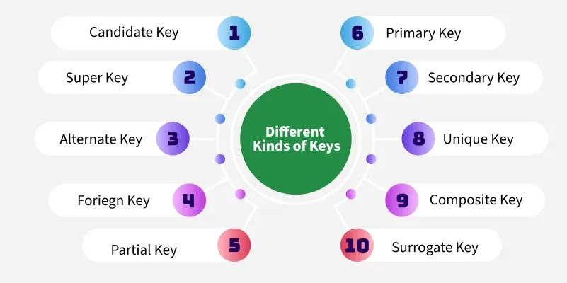

Slide 4
Significance of Keys
Uniqueness: Keys ensure that each record in a table is unique and can be identified distinctly.
Data Integrity: Keys prevent data duplication and maintain the consistency of the data.
Efficient Data Retrieval: By defining relationships between tables, keys enable faster querying and better data organization.
Without keys, it would be extremely difficult to manage large datasets and queries would become inefficient and prone to errors.

Slide 5
1. Super Key
The set of one or more attributes (columns) that can uniquely identify a tuple (record) is known as Super Key.
CREATE TABLE Student (
RegNo INT,
Email VARCHAR(100),
Name VARCHAR(50),
UNIQUE (Email, Name)
);

Slide 6
2. Candidate Key
The minimal set of attributes that can uniquely identify a tuple is known as a candidate key.
Must possess atleast one unique key.
StudentID(PK) | Email(UNIQUE) | Phone | Name
101 | john@example.com | 1234567890 | John Doe
102 | jane@example.com | 9876543210 | Jane Smith

Slide 7
Guess the answer!
Candidate Keys: _________________________

Slide 8
Guess the answer!
Candidate Keys: {EmpID}, {Email}
Super Keys:
{EmpID},
{Email},
{EmpID, Name},
{Email, Name},
{EmpID, Email}, etc.

Slide 9
Points to Recall!
Candidate keys are the minimal super keys.
Candidate keys are the minimal set of attributes that uniquely identify each tuple (row) in a relation.
Note:
Every candidate key is a super key, but not every super key is a candidate key.

Slide 10
3. Primary Key
A primary key is a unique key, meaning it can uniquely identify each record (tuple) in a table.
It must have unique values and cannot contain any duplicate values.
A primary key cannot be NULL

Slide 11
Primary Key → Implemented using PRIMARY KEY
Candidate Key → Implemented using PRIMARY KEY or UNIQUE
Super Key → Any set of attributes that uniquely identifies a row. There is no separate SQL syntax for defining a super key.

Slide 12
Say True or False
Primary key is always a candidate key, but not all candidate keys are primary keys.
Answer:

Slide 13
Guess the answer!
Candidate Keys: {EmpID}, {Email}
Super Keys:
{EmpID},
{Email},
{EmpID, Name},
{Email, Name},
{EmpID, Email}, etc.

Slide 14
4. Alternate Key (Secondary key)
An alternate key is any candidate key in a table that is not chosen as the primary key.
In other words, all the keys that are not selected as the primary key are considered alternate keys.
May contain one or more columns that can uniquely identify a record, but it is not the primary key.
Example: {Email}

Slide 15
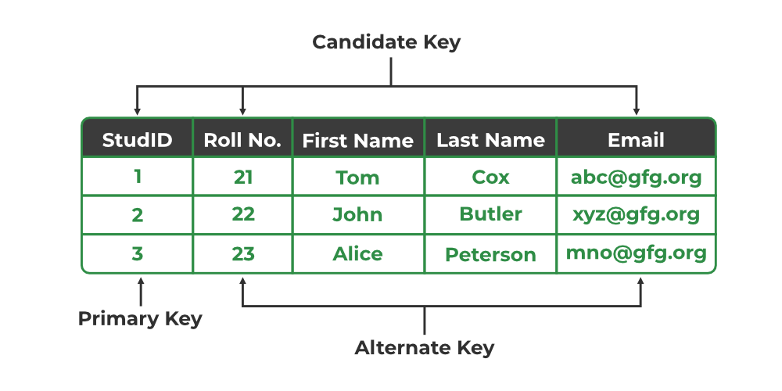

Slide 16
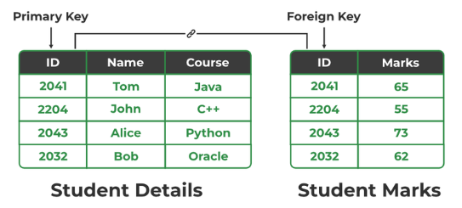
5. Foreign Key
A foreign key is an attribute in one table that refers to the primary key in another table.
The table that contains the foreign key is called the referencing table and the table that is referenced is called the referenced table.

Slide 17
6. Composite Key
A composite key is a combination of two or more columns used together to uniquely identify a row in a table.
No single unique column is available.

Slide 18
Example #1:
BookID | LibraryBranchID | CopiesAvailable
B001 | LB01 | 3
B001 | LB02 | 5
B002 | LB01 | 2
Neither BookID nor LibraryBranchID alone is unique.
Together, (BookID, LibraryBranchID) form a composite key.

Slide 19
Example #2:
StudentID | CourseCode | Semester | Grade
S101 | CSE201 | Fall2025 | A
S101 | CSE202 | Fall2025 | B
S102 | CSE201 | Fall2025 | B+

Slide 20
7. Partial Key
A partial key is a subset of a composite key that can uniquely identify a row in a related (weak) entity set, but only when combined with a foreign key from a strong entity.
Example:
Strong Entity: Employee(EmpID)
Weak Entity: Dependent(Name, EmpID, Age)
Here, Name is partial key It is not unique globally, but unique within the context of an EmpID.

Slide 21
A partial key is an attribute (or set of attributes) of a weak entity that uniquely identifies an entity only when combined with the primary key of its associated strong entity.
It is used only when there is a strong – weak entity set.

Slide 22
Strong Entity: Employee
EmpID (Primary Key) | EmployeeName
E101 | John
E102 | Alice
E103 | David
Weak Entity: Dependent
Primary Key = (EmpID, Name)
EmpID (Foreign Key) | Name (Partial Key) | Age | Relationship
E101 | Rahul | 10 | Son
E101 | Priya | 8 | Daughter
E102 | Rahul | 12 | Son
E103 | Meera | 35 | Wife

Slide 23
Why the “Partial”?
Name = Rahul is not unique across all employees.
But (EmpID, Name) is unique.
Otherwise:
Composite Primary Key of Weak Entity: (EmpID, Name)

Slide 24
CREATE TABLE Employee (
EmpID VARCHAR(10) PRIMARY KEY,
EmployeeName VARCHAR(50)
);
CREATE TABLE Dependent (
EmpID VARCHAR(10),
Name VARCHAR(50),
Age INT,
Relationship VARCHAR(20),
PRIMARY KEY (EmpID, Name), # Partial key
FOREIGN KEY (EmpID) REFERENCES Employee(EmpID) # Foreign Key
);

Slide 25
8. Surrogate Key
A surrogate key is a system-generated unique identifier (like an auto-increment number) used as a primary key, especially when no natural key is suitable.
Example:
ID (Surrogate Key) | Name | Email
1 | John Doe | john@example.com
2 | Jane Smith | jane@example.com

Slide 26
In Oracle 12c+ versions
CREATE TABLE employees (
emp_id NUMBER GENERATED ALWAYS AS IDENTITY PRIMARY KEY,
emp_name VARCHAR2(100),
department VARCHAR2(50)
);

Slide 27
In MYSQL
CREATE TABLE employees (
emp_id INT AUTO_INCREMENT PRIMARY KEY,
name VARCHAR(100),
department VARCHAR(50)
);
emp_id is the surrogate key
It will automatically increment with each inserted row

Slide 28
In Oracle 9i version(Using SEQUENCE)
CREATE TABLE Employee (
EmpID NUMBER PRIMARY KEY,
EmpName VARCHAR2(50),
Salary NUMBER
);
-- Create a sequence
CREATE SEQUENCE Emp_Seq START WITH 1 INCREMENT BY 1;

Slide 29
INSERT INTO Employee VALUES (Emp_Seq.NEXTVAL, 'John', 50000);
INSERT INTO Employee V
ALUES (Emp_Seq.NEXTVAL, 'Alice', 60000);
EmpID | EmpName | Salary
1 | John | 50000
2 | Alice | 60000

Slide 30
Surrogate Key as the Primary Key (Recommended)
CREATE TABLE employees (
emp_id INT AUTO_INCREMENT PRIMARY KEY, -- surrogate key
email VARCHAR(100) UNIQUE, -- natural key
name VARCHAR(100)
);

Slide 31
Interpret?
CREATE TABLE employees (
email VARCHAR(100) PRIMARY KEY, -- natural key
emp_id INT AUTO_INCREMENT UNIQUE, -- surrogate key (not
primary)
name VARCHAR(100)
);

Slide 32
Downside:
Surrogate key loses its benefits unless it's the actual primary key.

Slide 33
Final Advice!
Use surrogate key as the primary key if:
You want abstraction from business logic
You need performance, flexibility
Your natural keys may change, are long strings, or expose sensitive data.

Slide 34
Secondary Key
A Secondary Key is an attribute or a combination of attributes that is used for searching or retrieving records, but does not uniquely identify each row.
A Secondary Key is a non-unique attribute (or set of attributes) used to improve data retrieval based on common search criteria.

Slide 35
EmpID (PK) | Name | Department | Salary
E101 | John | HR | 50000
E102 | Alice | IT | 60000
E103 | David | IT | 55000
E104 | Priya | HR | 52000
E105 | Rahul | Finance | 65000
Example:
Primary Key: EmpID (uniquely identifies each employee)
Secondary Key: Department
The value IT appears for multiple employees, so it is not unique

Slide 36
SELECT * FROM Employee WHERE Department = 'IT'; -- Secondary key = Department
EmpID | Name | Department | Salary
E102 | Alice | IT | 60000
E103 | David | IT | 55000

Slide 37
EmpID (PK) | Name | Department | Salary
E101 | John | HR | 50000
E102 | Alice | IT | 60000
E103 | David | IT | 55000
E104 | Priya | HR | 52000
E105 | Rahul | Finance | 65000
E106 | Bob | IT | 60000
Example:
Primary Key: EmpID (uniquely identifies each employee)
Secondary Key: Department and Salary
The value IT and Salary appears for multiple employees, so it is not unique

Slide 38
SELECT * FROM Employee WHERE Department = 'IT‘ and Salary >=60000; -- Composite Secondary key = Department and Salary
EmpID | Name | Department | Salary
E102 | Alice | IT | 60000
E106 | Bob | IT | 60000

